Slide 1
Checking Compatibility of Bit Sizes in Floating Point Comparison Operations
Manuel Fahndrich
Francesco Logozzo
MSR - Redmond

Slide 2
Some background
Specification and contracts
Preconditions, postconditions, object invariants
Documentation
Make assumptions explicit in the code
Testing
Check more at runtime
Inheritance, object invariants
Static verification
Enable rely/guarantee reasoning
Analyze partial code in isolation

Slide 3



CodeContracts
Specify code with code
No new language to learn
Part of .NET v4.0
Advantages
No new language/compiler
Uniform & well-defined semantics: IL
Language agnostic
…

Slide 4
Clousot
Aka: cccheck.exe
Based on abstract interpretation
≠ all other tools for static contracts checking
Why?
Infer loop invariants
Provide loop invariants/templates just unrealistic
Focused and tunable
Specialized abstract domains on properties of interest
Predictable
Understand what the analyzer is doing and why…

Slide 5
Clousot main loop
Modular analysis
Use contracts for rely/guarantee reasoning
Inference to reduce annotation burden
Analyze the method to discover facts
Nonnull, numerical, arrays, arithmetic …
Use facts to discharge proof obligations
On failure
Use more precise abstract domain
Suggest contract
Report warning

Slide 6
Demo!
The most classical example!
Bank account

Slide 7
CodeContracts tools
Documentation
Generate it from the source code
Programmer should not duplicate it
Testing
Enforced by binary rewriting
Insert checks at the right spots
Postconditions on exits
Inheritance
Static verification: Clousot
With abstract interpretation ☺

Slide 8
Verification demo

Slide 9
So is my talk done?
Let’s demo the runtime checking

Slide 10
Disaster!!!!
Unsoundness
Static verification says: ok
Runtime says: wrong!
Real bug!!!!
Reported by one of our customers

Slide 11
What’s going on?
Clousot does this proof
But it is wrong
Why? Ideas? Suggestions?
(except if you already read the paper… ☺)
 | assert balance == old(balance) + amount
⇔ | { assignment: balance = old(balance) + amount }
 | old(balance) + amount == old(balance) + amount
⇔ | { Precondition & invariant imply !NaN, equality }
 | true

Slide 12
Possible causes
Overflows?
No: Floats do not overflow (get ±∞)
Non-determinism?
No: Single thread, IEEE754
Cancellation?
No: positive, same order of magnitude
No-associativity for +?
No: adding two numbers
Comparison…
Yes: but why?

Slide 13
Comparison (==)
Problematic with floats
To be avoided
But why here?
Adding the same two quantities
Comparing them for equalities
Rounding should be the same both times
Or not?

Slide 14

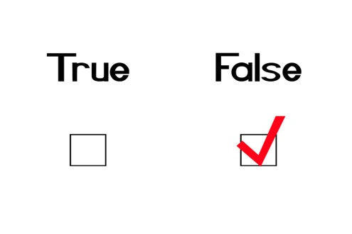
In the example (concrete)
tmp = 9.42477822
balance= 9.424778

Slide 15
Deep in the CLR specification
Floats in store locations are 32 or 64 bits
Store locations: fields, array elements
Floats in locals are 32, 64 or machine dep.
Locals: parameters, return value, stack vars
Operation results are saved in locals
Ergo, may have a value larger than nominal type
Store write cause narrowing (of values…)
Ergo, values are truncated

Slide 16
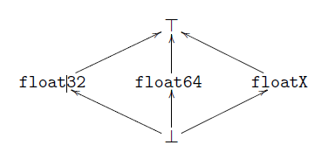
Compatibility analysis
Very easy once we identified the problem
Abstract domain:
Transfer functions: easy

Slide 17
In the example (abstract)
tmp = floatX
balance= float32

Slide 18
Soundness is back!
Demo!

Slide 19
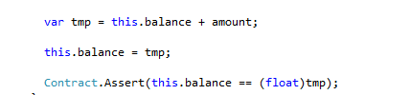
Fix for the program?
Add an explicit cast
tmp is float32
(float32) tmp should be a nop
But it is not!!!

Slide 20
Implementation
Implemented in our analyzer
Make the user who reported the bug happy
Found bugs in production code
class C {
float a; // should never be 0.0F
void Update(float f) {
if (IsNonZero(f)) {
this.a = f; } }
bool IsNonZero(float f) {
return f != 0.0F;
}
}

Slide 21
Conclusions
Analyzers should track store/locals for floats
Otherwise unsound analysis
Similar for Intel/ARM, C#/Java
Implemented in Clousot/cccheck
Download it at DevLabs
Found bugs in real code

